Slide 1
Chapter-4 BUS STRUCTURE In any microprocessor system, the system bus consists of a number of separate lines. Each line is assigned a particular function. Fundamentally in any system, the system bus can be classified into three functional groups: the address, the data and control lines or buses. 1. Data Bus > The data bus provides path for transferring data between the microprocessor system and the peripherals. > The data bus consists of a number of separate lines, generally 8, 16, 32 or 64. The number of lines is referred as the width of the data bus. > Since, each line carry only one bit at a time, the number of lines determines how many bits can be transmitted at a time. > The width of data bus is a key factor in determining the overall system performance. 2. Address Bus > The address bus which consists of a number of separate lines, are used to designate the source or destination of the data on data bus. For example, if the CPU requires reading a word (8, 16, 32 or 64 bits of data) from memory, it put the address of the desired word on the address bus. > The width of address bus (i.e number of lines) determines the maximum possible memory capacity of the system. > The address bus is also used to address IO ports.

Slide 2
3. Control Bus > The control bus is a group of lines used to control the access to and the use of the data and address bus since the data and address bus are shared by all components of microcomputer system. Hence control bus provides a means of controlling their use. > The control bus carries the control signals. The control signals transmit both command and timing information between the system modules. > The timing signals indicate the validity of data and address information; whereas the command signals specify the operations to be performed. > Some control signals are: Memory Read, Memory Write, IO Read, IO Write, Interrupt Request, Interrupt Acknowledge, Bus request, Bus Grant etc. SYNCHRONOUS AND ASYNCHRONOUS BUS Synchronous Bus In a synchronous bus, the occurrence of the events on the bus is determined by a clock. The clock transmits a regular sequence of 0's and 1's of equal duration. A single 1-0 transition is called clock cycle or bus cycle and defines a time slot. All other devices on the bus can read the clock live, and all events start at the beginning of the clock cycle. In synchronous bus, all devices are tied to a fixed rate, and hence the system cannot take advantage of device performance. It is easier to implement. Asynchronous Bus In an asynchronous bus, the timing is maintained in such a way that occurrence of one event on the bus follows and depends on the occurrence of previous event. Asynchronous bus are faster than the synchronous bus as the events are independent of the processor timing.

Slide 3
MEMORY DEVICES
> In a microcomputer system, the memory is used to store both instructions and data. A memory can be volatile or non-volatile. The contents of a volatile memory are lost if power is turned off; whereas the non-volatile memory retains its contents after the power is switched off. > A microcomputer's memory system can be divided into three groups: a) Processor Memory b) Primary or Main Memory c) Secondary Memory a) Processor Memory > Microprocessor's registers and cache memory are referred to as processor memory. > The registers are used to hold results temporarily when computation is in progress. The speed of registers is equal to the speed of microprocessor, since they are fabricated using the same technology. Although the use of registers enhances the execution speed, the cost involved in the approach forces the microprocessor designers to include only few registers inside the processors. > Beside registers, these days microprocessor also consists of a separate memory in order to store the frequently needed information, known as cache memory. The speed and efficiency of program execution has been significantly improved by the use of cache memory.

Slide 4
b) Primary/Main Memory It is the storage area where all programs are executed. The microprocessors can directly access only those items that are stored in primary memory. Hence, all programs and data must be in primary memory prior to execution. Primary memories can be divided into two main groups: > Random Access Memory (RAM) > Read Only Memory (ROM) Random Access Memory (RAM) From its name itself, it is obvious that this memory uses random access mode. It is read/write memory i.e information can be read from it or can be written on it. However, it is volatile in nature. Being random access mode, it is faster with access time in nano seconds. The Random Access Memories are basically of two types: > Dynamic RAM (DRAM) > Static RAM (SRAM) Dynamic RAM: Dynamic RAM stores data in capacitors; it can hold data for few milliseconds. Thus dynamic RAM need to be refreshed by using external refresh circuitry. The charging of capacitor and refreshing is done by MOS transistors. Due to its small storage cell, DRAM exhibits compactness i.e. greater number of bits can be stored in small chips. Thus, DRAMs are cheaper than SRAM. However the interfacing circuit of DRAM is complicated because of refreshing circuit. Static RAM: The static RAM is made up of flip-flops. A single flip-flop stores one bit information i.e. 0 or 1. Each flip-flop is called storage cell of the memory device. The individual storage cell is addressed with the help of row and column decoder in the SRAM

Slide 5
Read Only Memory (ROM) ROM can only be read. This is non-volatile in nature. ROMs are divided into two types: Bipolar ROMs and MOS ROMs. The bipolar ROMs are faster than MOS ROMs. Each type is further divided into two common types: Mask ROM and Programmable ROM (PROM). MOS ROMs contain one more type; erasable ROM (EPROM and EEPROM). > Mask ROMs are programmed by a masking operation performed on the chip during the manufacturing process. The content of Mask ROMs are permanent and cannot be changed by the user. > Programmable ROMs (PROMs) can be programmed by user by means of proper equipment. The content of this type of memory cannot be changed unless it is erased by special device. > EPROMs can be programmed by using PROM programmer. Its memory can be erased by exposing the chip via a window on a chip to ultraviolet light. EPROMs chip should be remove from the microcomputer system for programming. > EEPROMs can be erased and programmed without removing the chip from the microcomputer system. The content of EEPROMs can be erased electrically. c) Secondary Memory

Slide 6
Random Access Secondary Memory: A random access secondary memory uses the random access mode. In random access mode, any location of the memory can be accessed at random. In this mode, the memory access time is independent of the location from which data is accessed. Example: Semiconductor Memories > Sequential Access Memory: In these types of memory, the access method is strictly sequential. In sequential access memory, the memory access time depends on the location in which data is stored. They are also called serial access memories. Example: Magnetic Tapes > Semi random Access Memory: These memories combine both random and sequential access mode. This is done in order to achieve a compromise between random access and sequential access memories because the random access is more expensive than sequential access though it is much faster. Example: Floppy, Hard Disks

Slide 7
ADDRESS DECODING
The process of generating chip select signal (CS) using the address lines of the microprocessor and a decoder or logic-gates, to interface memory devices or IO devices with microprocessor is called address decoding. During address decoding, the address lines of a microprocessor is divided into two parts. N most significant lines and M list significant bits. The N most significant lines are passed to decoder/logic-gates to generate CS signal, whereas the M list significant lines are passed directly to the device (memory/IO). Address decoding is of two types: Full Address Decoding (Unique/Absolute Address Decoding) Partial Address Decoding (Non-Unique Address decoding) Full Address Decoding: If all the address lines of a microprocessor system is used to address a memory or IO devices, such address decoding is called full address decoding. The address of the memory/IO in this scheme is unique so it is also called unique address decoding or absolute address decoding. Partial Address Decoding: If all the address lines of microprocessor is not used i.e. only some address lines are used to address a memory location or IO device then it is called partial address decoding. The address of the memory location/IO device is not unique i.e. the memory or IO device may have two or more address. It is also called non-unique address decoding.

Slide 8
I/O Mapped I/O
I/O device is treated as an I/O device and hence given an I/O address
I/O device has an 8 or 16 bit I/O address.
I/O device is given IOR# and IOW# control signals
Decoding is easier due to lesser address lines
Decoding is cheaper

Slide 9
6. Works faster due to less delays
7. Allows max 2^16 = 65536 I/O devices
8. I/O devices can only be accessed by IN and OUT instructions.
9. ONLY AL/ AH/ AX registers can be used to transfer data with the I/O device
10. Popular technique in Microprocessors.

Slide 10
Memory Mapped I/O
I/O device is treated like a memory device and hence given a memory address.
I/O device has a 20 bit Memory address.
I/O device is given MEMR# and MEMW# control signals
Decoding is more complex due to more address lines
Decoding is more expensive

Slide 11
6. More gates add more delays hence slower
7. Allows many more I/O devices as I/O addresses are now 20 bits.
8. I/O devices can now be accessed using any memory instruction.
9. Any register can be used to transfer data with the I/O device
10. Popular technique in Microcontrollers

Slide 12
Assignment
What do you mean by address decoding? Differentiate between partial and full address decoding.
Differentiate between synchronous and asynchronous bus.
Design an address decoding circuit to interface 16kb ram, 8kb rom and 4kb Eprom.
Design an address decoding circuit to interface 16kb ram, 8kb rom and 4kb EEPROM with starting address 8000H.

Slide 13
What is memory interfacing?Defferentiate between I/O mapped and memory mapped I/O. Design an address decoding circuit to interface two rams blocks and ROM block each of 4kb starting address 4000H.

Slide 14
Chapter 5
Interrupt

Slide 15
INTRODUCTION
Interrupt is considered as an emergency signal to which the MP responds as soon as possible. When the microprocessor receives an interrupt signal, it suspends the current executing program and jumps to an interrupt service routine (ISR) to respond to the incoming interrupt When a device interrupts, it actually wants the microprocessor to give a service which is equivalent to asking the microprocessor to call a subroutine. This subroutine is call Interrupt Service Routine (ISR). SOURCES OF INTERRUPTS There are three sources of interrupts and they are as follows: 1. Processor Interrupt 2. Software Interrupt 3. Hardware Interrupt Processor Interrupt These interrupts are generated by processor itself, usually in response to an error condition. For example: In 8086 Type 0 interrupt occurs when attempt to divide by zero which is a processor interrupt. Software Interrupt These are special instructions that trigger an interrupt response to processor. In 8086 the general form of software interrupt instruction is INT nnH (eg: INT 21H) Hardware Interrupt Hardware interrupts are interrupt request initiated by external hardware. 8086 have two pins reserved for hardware interrupts. They are NMI and INTR

Slide 16
CLASSIFICATIONS OF INTERRUPTS
Interrupts can be classified as: > Maskable Interrupt or Non-Maskable Interrupt > Vectored Interrupt or Non-Vectored Interrupt Maskable Interrupt > The interrupts which can be blocked or delayed by using instructions are called maskable interrupts. > In 8085, the RESET interrupts (RST 5.5, RST 6.5 and RST 7.5) and INTR are maskable interrupts. They can be enabled/disabled by using instructions EI/DI. > In 8086, INTR is maskable interrupt. It can be enabled/disabled by using instructions STI/CLI. Non-Maskable Interrupt > Those interrupts which cannot be blocked by instructions are termed as non-maskable interrupts. > In 8085, TRAP is only non-maskable interrupt and it is used for power failure and emergency cutoff. > In 8086, NMI is non-maskable interrupt.

Slide 17
Vectored Interrupt > The interrupts for which address of ISR is already known to MP are called vectored interrupts. > In 8085, RESET interrupts (RST 5.5, RST 6.5 and RST 7.5) are vectored interrupts.
Interrupt Vector Address (Hex) RST 5.5 002C RST 6.5 0034 RST 7.5 003C Non-Vectored Interrupt > In non-vectored interrupts, the interrupting device needs to supply the address of the ISR to the microprocessor. > In 8085, INTR is non-vectored interrupt.

Slide 18
8085 INTERRUPTS
8085 microprocessor consists of five interrupt signals: INTR, RST 5.5, RST 6.5, RST 7.5 and TRAP. 1. INTR (Interrupt Request) > The INTR is only non-vectored interrupt. > INTR is maskable interrupt and can be masked by using EI (Enable Interrupt)/DI (Disable Interrupt) instruction pair. > INTR can be used for external hardware interrupts for various applications. 2. RESET Interrupts > 8085 consists of three reset interrupts: RST 5.5, RST 6.5 and RST 7.5 > They are vectored interrupts whose address are defined in interrupt vector table > They are maskable interrupts and can be enabled or disabled individually by using RIM and SIM instructions.
Interrupt Vector Address (Hex) TRAP 0024 RST 5.5 002C RST 6.5 0034 RST 7.5 003C 3. TRAP > It is only non-maskable interrupt of 8085 MP. > It is a vectored interrupt whose address is defined in interrupt vector table. > It is used as external hardware interrupt source and is used for power failure and emergency shutoff instruction.

Slide 19
8086 INTERRUPTS
> An 8086 interrupt can come from any one of 3 sources. > One source is an external signal applied to the Nonmaskable Interrupt (NMI) or to the (INTR) input pin. An interrupt caused by a signal applied to one of these inputs (NMI or INTR) is referred as Hardware Interrupt. > A second source of an interrupt is execution of the interrupt instruction INT nn. This is referred as Software Interrupt. > The third source of an interrupt is some error conditions produced in 8086, by the execution of an instruction, referred as processor interrupt. INTERRUPT VECTOR TABLE (IVT) > 8086 consists of 256 interrupts stored from memory location 00000H to 003FFH i.e. 1024 Bytes (1KB) of memory. > These 256 interrupts are stored in memory location forming a table which is called Interrupt Vector Table (IVT). > An Interrupt Vector contains the address (segment CS and offset IP) of the Interrupt Service Routine. > Each vector is a 4 byte long and contains the starting address of the Interrupt Service Routine. > The first 2 bytes of the vector contain the offset address (IP) and the last two bytes contain the segment address (CS).
8086 PREDEFINED INTERRUPT TYPES 1. DIVIDE BY ZERO INTERRRUPT: TYPE 0 > Divide error occurs when the result of division overflow or whenever an attempt is made to divide by zero. > The 8086 type 0 is automatic and cannot be disabled in any way 2. SINGLE STEP INTERRUPT : TYPE 1 > If the 8086 trap flag is set, the 8086 will automatically do a type 1 interrupt after each instruction executes. > When a MP is interrupted using Type 1 interrupt, it will execute one instruction and stop so that we can then examine the contents of registers and memory locations. > In other words, in single step mode, a system will stop after it executes each instruction and waits for further direction from us.

Slide 20
3. NON MASKABLE INTERRUPT : TYPE 2 > A result of placing logic 1 on the NMI input pin causes type 2 interrupt. > This input is non-maskable, which means that it cannot be disabled. > Another common use of type 2 interrupt is to save program data in case of a system power failure or to deal with some other catastrophic failure conditions. > Some external circuitry detects when the AC power to the system fails and sends an Interrupt signal to the NMI. 4. BREAKPOINT INTERRUPT : TYPE 3 > Used to insert a breakpoint into the program. When a break point is inserted, the system executes the instructions up to the breakpoint, and then stops execution. > The INT 3 instruction is often used to store a breakpoint in a program for debugging. 5. OVERFLOW INTERRUPT : TYPE 4 > A special vector used with the INTO instruction. > The 8086 overflow flag, OF, will be set if the signed result of an arithmetic operation on two signed numbers is too large to be represented in the destination register or memory location. > The INTO instruction interrupts the program if an overflow condition exists as reflected by overflow flag (OF).

Slide 21
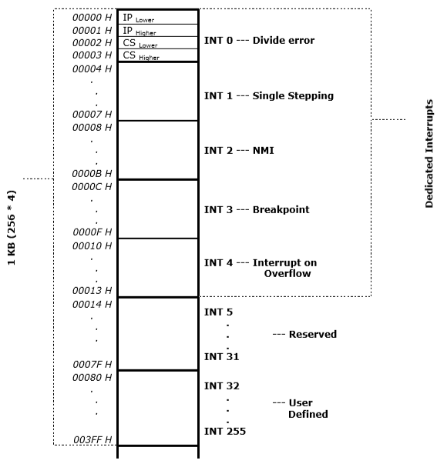
Interrupt vector table

Slide 22
PRIORITISING INTERRUPTS
PRIORITISING INTERRUPTS
1. Polled Interrupts
A polling procedure is used to identify the interrupt source having the highest priority. Only one branch address is used for all interrupts. The priority of each interrupt source determines the order in which it is polled. The source with the highest priority is tested first, and if its interrupt signal is on, control branches to a routine that services that source. Otherwise, the source with the next lower priority is tested, and so on.
2. Vectored Interrupt
A vectored interrupt unit functions as an overall manager in an interrupt system environment. The unit accepts interrupt requests from many sources, determines which request has the highest priority, and issues an interrupt request to the computer based on this determination. To speed up the operation, each interrupt source has its own interrupt vector address to access its own service routine directly.

Slide 23
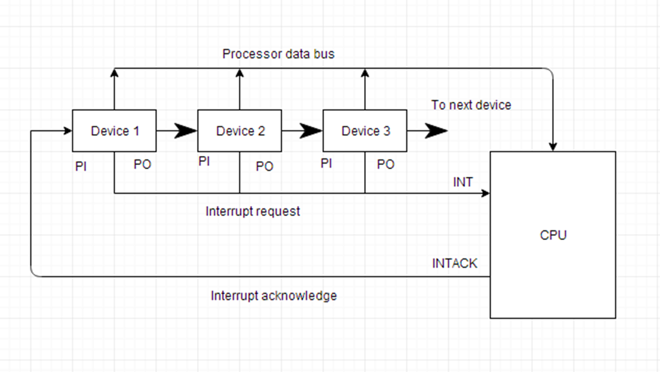

Slide 24
Operation:
1. All devices that can request an interrupt are connected serially and in priority order with the highest priority device placed first on the daisy chain, farthest from the CPU, and the lowest priority device placed last and closest to the CPU.
2. First, any (or all) of the devices signal an interrupt on the Interrupt Request line.
3. Next, the CPU acknowledges the interrupt on the Interrupt Acknowledge line.
4. A device on the line passes the Interrupt Acknowledge signal to the next lower priority device only if it has NOT requested service.
5. The first device on the priority chain requiring service asserts it interrupt vector address (VAD) on the CPU data bus.
6. The CPU services the device
7. The Interrupt Acknowledge signal is passed to the next lower priority device and steps 2 to 6 are performed for the next lower priority device.

Slide 25
CHAPTER 5:Assignment
1. What is an interrupt? Explain how interrupt is processed by a microprocessor.
2. What is ISR? Explain the sources of interrupts with examples.
3. Differentiate between maskable, non-maskable interrupts and vectored, non-vectored interrupts.
4. What do you mean by IVT. Explain.
5. Explain 8086 predefined interrupts.
6. What are the applications of Non-maskable interrupts. Explain with a suitable example.
7. What do you mean by Vectored and Pooled Interrupts.
8. Explain various interrupts of 8085 Microprocessor.

